Slide 1
CS 4530: Fundamentals of Software Engineering
Module 3, Lesson 4
Concurrency Patterns in Typescript
Rob Simmons
Khoury College of Computer Sciences

Slide 2
Learning Goals for this Lesson
At the end of this lesson, you should be prepared to:
  Explain the difference between JS run-to-completion semantics and interrupt-based semantics.
  Given a simple program using async/await, work out the order in which the statements in the program will run.
  Write simple programs that create and manage promises using async/await
  Write simple programs to mask latency with concurrency by using non-blocking IO and Promise.all in TypeScript.
Notes:
<read slide>

Slide 3
Javascript/Typescript uses cooperative multiprocessing
Typescript maintains a pool of processes, called promises.
A promise always executes until it reaches its end (i.e., a promise cannot be interrupted).
This is called "run-to-completion semantics".
A promise can create other promises to be added to the pool.
Promises interact mostly by passing values to one another; data races are minimized.
Notes:
In cooperative multiprocessing, each thread decides when it should yield to let other threads execute. For the purposes of this lecture, we will use the terms 'promise' and 'computation' interchangeably (MAYBE??)

Slide 4
A promise can be in one of exactly 3 states
A JavaScript promise can be in one of three states: pending, fulfilled, or rejected.
Pending is the initial state where the promise is waiting for an operation to complete;
Resolved: either fulfilled or rejected.
  fulfilled means the operation was successful,
  rejected indicates that the operation failed.
Notes:
<read slide>. Say something about success/failure?

Slide 5
Subcategories of Pending Promises
Waiting: pending, and some of the operations it was waiting for have not yet completed
Ready for Execution: pending, but all the operations it was waiting for have completed
Executing: pending (not resolved), but the code of the promise is currently being executed
There can be at most one executing promise at any time
Notes:
Since JS is single-threaded language, you can’t execute more than one “thing” at any time!

Slide 6
A snapshot of the promise pool
p100
p50
p25
The grey promises are fulfilled
p101
p51
p26
The green promises are pending and ready
The yellow promises are waiting.
p102
p27
The white promise is the currently executing promise
The arrows indicate that one promise is waiting for another
Notes:
Here we have a picture of the promise pool. Promise 101 is the currently executing promise.
It's also possible for more than one promise to be waiting for a given promise, or for a promise to be waiting for more than one other promise, but you generally won't run into that when you use the patterns we discuss.

Slide 7
When the currently executing promise succeeds, the pool will look like this:
p100
p50
p25
The grey promises are fulfilled
p101
p51
p26
The green promises are pending and ready
The yellow promises are waiting
p102
p27
The white promise is the currently executing promise
The currently executing promise may have created some new promises, not shown here. Some of them might be ready, too.
The arrows indicate that one promise is waiting for another
Notes:
Here we have a picture of the promise pool after the currently executing promise succeeds. Note that p102, the promise in the lower-left-hand corner, which used to be yellow (pending), is now green (ready).
The currently executing promise may have created some new promises, not shown here. Some of them might be ready, too.

Slide 8
Any ready promise can be chosen as the next promise to be executed
p100
p50
p25
The grey promises are fulfilled
p101
p51
p26
The green promises are pending and ready
The yellow promises are waiting
p102
p27
The white promise is the currently executing promise
The arrows indicate that one promise is waiting for another
Notes:
In this case, any of p102, p50, or p26 could be chosen as the next promise to be executed.

Slide 9
Computations always run until they are completed.
Execution of a promise cannot be interrupted. That's what we mean by "run to completion".
Along the way, it may create promises that can be run anytime after the current computation is completed (i.e. they will be in the "waiting" state).
  We'll see that async/await provides an easy way to do that.
A computation is completed when it returns from a procedure, but there are no procedures for it to return to (i.e. it returns to the "top level")
When the current computation is completed, the operating system (e.g. node.js) chooses some "ready" promise to become the next current computation.
Notes:
The idea that a computation runs until it completed is known as “Run to completion” semantic. JS event handler will not get “interrupted” and it will continue its work on the current task. This is true even when you create another async task because that async task will not start executing right away. The control will not switch over to any other task.

Slide 10

Programming with promises
Typescript has primitives that create promises.
  But you will never do this
Some typescript libraries have API procedures that return promises
  this is the usual way you'll get promises.
Most of the time, you'll be building new promises out of the ones that are given to you.
This is what async/await does…
This Photo by Unknown Author is licensed under CC BY-NC
Notes:
We've talked about the behavior of promises. But how do we program with them?

Slide 11
Use async functions to create promises
Typically, an async function gets a promise (from somewhere) and returns another promise.

Slide 12
Example:
/** given a string, returns a promise that prints a string
* and then resolves.
**/
import promiseToPrint from "./promiseToPrint";
export async function example1(n: number): Promise<void> {
console.log(`example1(${n}) starting`);
const p1 = promiseToPrint(`example1(${n}) is printing`);
await p1;
console.log(`example1(${n}) finishing`);
}
src/async-await/example1.ts
Notes:
Review the code. Explanation on next slide

Slide 13
async/await: from the inside out
export async function example1(n: number): Promise<void> {
console.log(`example1(${n}) starting`);
const p1 = promiseToPrint(`p1 is printing`);
await p1;
console.log(`example1(${n}) finishing`);
}
This function executes normally until it hits the await, printing out "example1(1) starting" and binding p1 to the value of promiseToPrint('p1 is printing')
When it hits the await, it takes all the code following the await and creates a new promise that can only be executed after p1 is completed.
The new promise becomes the value of example(n).
The caller of example(n) then continues its execution.
If example(n) has no caller, then the runtime system chooses some ready promise to execute.
Notes:
A more common pattern is for the async function to be used in combination with await. <READ SLIDE> <click when you read "it does three things">
This is an async function; async functions return promises, which this one does (ok!)

Slide 14
The promise pool before before calling example1()
{
const res =
example1(10);
//..more code..
}
Notes:
Here's an example, showing a little more detail.

Slide 15
The promise pool after calling example1()
{
const res =
//..more code..
}
console.log( `example1(10) finishing`
);
example1(10) starting
p1 is printing
Important:
The console.log can't run until
after the 'more code' finishes
Notes:
example1(10) prints out the message "example1(10) starting".
promiseToPrint prints out the message; “p1 is printing”) and then resolves, leaving the console.log (“example1(10) finishing”) ready to execute. But there may be more code in the active promise, so the console.log can't run until that code is finished.
This may look like an odd value for the async to return, but it actually works out well…

Slide 16
Async functions: from the outside in
What can async functions do?
What are the typical patterns for applying them?
Notes:
So far we've talked about async functions "from the inside out". Now let's look at them "from the outside in": how they appear to the functions that call them and how we can use them to build interesting things.
We'll present a series of examples to illustrate typical patterns for using async functions.

Slide 17
Async functions return promises
export async function example1(n: number) {
console.log(`example1(${n}) starting`);
const p1 = promiseToPrint(`p1 is printing`);
await p1;
console.log(`example1(${n}) finishing`);
}
function main1() {
console.log('starting main');
const res = example1(10)
console.log ('example1(10) returned', res)
console.log('main finished');
}
main1();
$ npx ts-node AsyncReturnsPromise.ts
starting main
example1(10) starting
p1 is printing
example1(10) returned Promise { <pending> }
main finished
example1(10) finishing
src/async-await/AsyncReturnsPromise.ts
Notes:
Notice
the example1(10) finishing doesn't print until AFTER main1 finishes
the console.log of res isn't something we would normally do, but it demonstrates that example1(10) returned a promise to its caller (main1) (and also that this promise is in the 'pending' state.

Slide 18
Asyncs can be nested
src/async-await/nestedAsyncs.ts
export async function example2(n: number): Promise<void> {
console.log(`example2(${n}) starting`);
const p1 = example1(n);
await p1;
console.log(`example2(${n}) finishing`);
}
function main() {
console.log('starting main');
example2(10)
console.log('main finished');
}
main();
$ npx ts-node nestedAsyncs.ts
starting main
example2(10) starting
example1(10) starting
p1 is printing
main finished
example1(10) finishing
example2(10) finishing

Slide 19
Running Multiple Promises Asynchronously
export async function example1(n: number) {
console.log(`example1(${n}) starting`);
const p1 = promiseToPrint(`p1 is printing`);
await p1;
console.log(`example1(${n}) finishing`);
}
function make3AsynchronousPromises() {
console.log('starting make3AsynchronousPromises');
example1(100);
example1(200);
example1(300);
console.log('make3AsynchronousPromises finished');
}
make3AsynchronousPromises()
$ npx ts-node ThreeAsynchronousPromises.ts
starting make3AsynchronousPromises
example1(100) starting
p1 is printing
example1(200) starting
p1 is printing
example1(300) starting
p1 is printing
make3AsynchronousPromises finished
example1(100) finishing
example1(200) finishing
example1(300) finishing
src/async-await/ThreeAsynchronousPromises.ts
Notes:
<click to make output appear>
Here we see that the "asynchronous" portions of example1 are not executed until after their caller has finished.
Note that any of the 3 pending promises may complete before others. It really depends on what the async operation is. For example, if they all fetch something from the web, one request may take longer than other and hence may finish later than others. For trivial tasks they might finish in same order as started (but that’s not guaranteed).

Slide 20
Running Multiple Promises Sequentially
export async function example1(n: number): {
console.log(`example1(${n}) starting`);
const p1 = promiseToPrint(`p1 is printing`);
await p1;
console.log(`example1(${n}) finishing`);
}
async function make3SequentialPromises() {
console.log('starting make3SequentialPromises');
await example1(100);
await example1(200);
await example1(300);
console.log('make3SequentialPromises finished');
}
make3SequentialPromises()
$ npx ts-node ThreeSequentialPromises.ts
starting make3SequentialPromises
example1(100) starting
p1 is printing
example1(100) finishing
example1(200) starting
p1 is printing
example1(200) finishing
example1(300) starting
p1 is printing
example1(300) finishing
make3SequentialPromises finished
src/async-await/ThreeSequentialPromises.ts
Notes:
If we say 'await example1()', then the rest of the caller doesn't execute until example1 is finished.
<click to show output>

Slide 21
Promises can pass values to one another
src/async-await/PromisesPassingValues.ts
export async function example1(n: number) {
console.log(`example1(${n}) starting`);
const p1 = promiseToPrint(`p1 is printing`);
await p1;
console.log(`example1(${n}) finishing`);
// pass this to any waiting promises
// this is NOT the value of the async function
return n+10;
}
async function promisesPassingValues() {
console.log('starting promisesPassingValues');
const res1 = await example1(100);
const res2 = await example1(res1);
const res3 = await example1(res2);
console.log(`res3 = ${res3}`);
console.log('promisesPassingValues finished');
}
$ npx ts-node PromisesPassingValues.ts
starting promisesPassingValues
example1(100) starting
p1 is printing
example1(100) finishing
example1(110) starting
p1 is printing
example1(110) finishing
example1(120) starting
p1 is printing
example1(120) finishing
res3 = 130
promisesPassingValues finished
Notes:
(Explain the 'return n+10') <click to show output>

Slide 22
Recover from failure with try/catch
// promise to fail if shouldFail is true
import { promiseMaybeFail } from './promiseMaybeFail'
async function script(shouldFail:boolean) {
console.log('starting script with shouldFail = ', shouldFail);
try {
await promiseMaybeFail(shouldFail)
console.log('promise succeeded');
}
catch (e) { console.log('promise failed, but error caught') }
console.log('script finished successfully');
}
async function main1() {
  await script(false);
  console.log('\n')
  await script(true)
}
main1()
$ npx ts-node recoveringFromPromiseFailure.ts
starting script with shouldFail = false
promise succeeded
script finished successfully
starting script with shouldFail = true
promise failed, but error caught
script finished successfully
src/async-await/recoveringFromPromiseFailure.ts

Slide 23
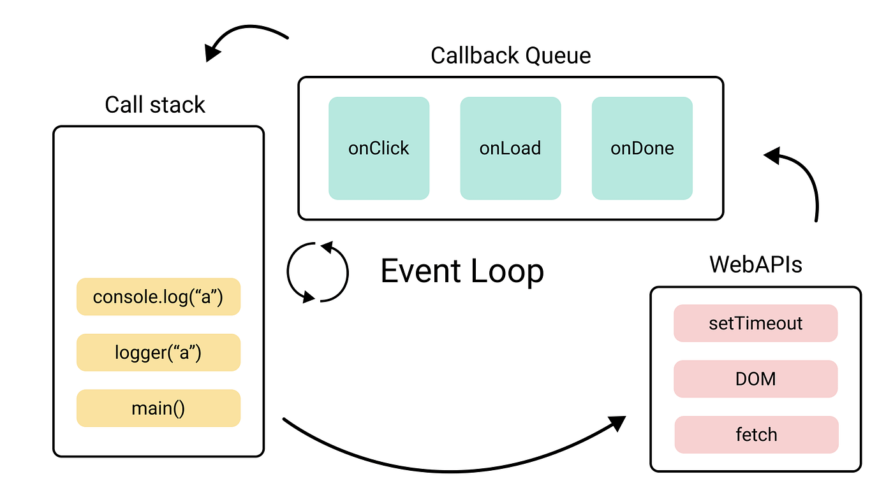
How does JS Engine make this happen?
One Event Loop means that we have single thread of execution
WebAPI are used for asynchronous tasks
Queues are used for “await”-ing tasks
When call stack gets empty, event loop picks up tasks from Callback Queue
Notes:
<read slide>.
- JS Engine includes a {single} call stack that keeps track of each function that it is being executed
- Asynchronous (heavy) tasks are outsourced to WebAPI. When those are completed, they are placed in a callback queue.
- Event loop picks up “awaiting” {completed} tasks from queue when call stack is empty (i.e., when it is done with everything it was working on – think run to completion) and processes them in the order they were added to queue (i.e., they were completed by WebAPI)

Slide 24
We achieve this goal using two techniques:
1. cooperative multiprocessing
2. non-blocking IO
But where does the non-blocking IO come from?
Notes:
That concludes our tour of cooperative multiprocessing.
But where does the non-blocking IO come from?

Slide 25
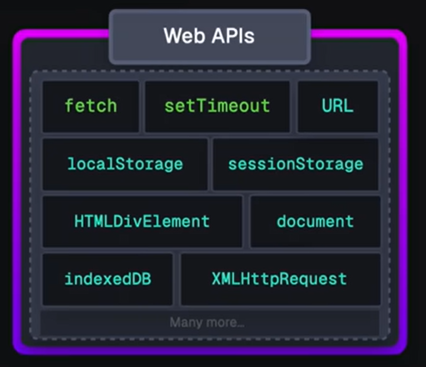
Answer: JS/TS has some primitives for starting a non-blocking computation
These are things like http requests, I/O operations, or timers.
Each of these returns a promise that you can await. The promise runs while it is pending, and produces the response from the http request, or the contents of the file, etc.
You will hardly ever call one of these primitives yourself; usually they are wrapped in a convenient procedure, e.g., we write
axios.get('https://rest-example.covey.town’)
to make an http request, or
fs.readFile(filename)
to read the contents of a file.
Notes:
This is what we said back on the slide with the stork, where we said "Some typescript libraries have API procedures that return promises"

Slide 26
Pattern for starting a concurrent computation using non-blocking I/O
export async function makeRequest(requestNumber:number) {
console.log(`starting makeRequest(${requestNumber})`);
const response = await axios.get('https://rest-example.covey.town');
console.log('request:', requestNumber, '\nresponse:', response.data);
}
The first console.log is printed
The http request is sent, using non-blocking i/o
A promise is created to run the second console.log after the axios.get returns
The makeRequest() returns to its caller.
Notes:
It is important to note that you can call makeRequest but it will be awaiting a future response. That promise was returned immediately back to the caller (whichever promise called the makeRequest) and that the caller’s thread continues on while makeRequest is waiting for a response, just as in our previous examples.

Slide 27
Running 3 concurrent requests
src/async-await/makeThreeConcurrentRequests.ts
import axios from 'axios';
export async function makeRequest(requestNumber:number) {
console.log(`starting makeRequest(${requestNumber})`);
const response = await axios.get('https://rest-example.covey.town');
console.log(`request:${requestNumber} returned`);
}
function make3ConcurrentRequests() {
console.log('starting make3ConcurrentRequests');
makeRequest(100);
makeRequest(200);
makeRequest(300);
console.log('make3ConcurrentRequests finished');
}
make3ConcurrentRequests()
$ npx ts-node makeThreeConcurrentRequests.ts
starting make3ConcurrentRequests
starting makeRequest(100)
starting makeRequest(200)
starting makeRequest(300)
make3ConcurrentRequests finished
request 300 returned
request 100 returned
request 200 returned
Notes:
Here, just to make the output easier to read, we've simplified makeRequest so that it prints out only the number of the request that was responded to.
Note that the responses don't arrive in the same order that they were sent!

Slide 28
Promise.all takes a list of promises, runs them concurrently, and succeeds only when they have all succeeded.
export async function makeRequest(requestNumber:number) {
console.log(`starting makeRequest(${requestNumber})`);
await axios.get('https://rest-example.covey.town');
console.log(`request ${requestNumber} returned`);
return requestNumber
}
async function manyConcurrentRequests(requests: number[]) {
console.log('starting manyConcurrentRequests');
const responses = await Promise.all(requests.map(n => makeRequest(n)));
console.log('responses:', responses);
console.log('manyConcurrentRequests finished');
}
async function main() {
manyConcurrentRequests([100,200,300,400])
}
main()
$ npx ts-node manyConurrentRequests.ts
starting manyConcurrentRequests
starting makeRequest(100)
starting makeRequest(200)
starting makeRequest(300)
starting makeRequest(400)
request 100 returned
request 300 returned
request 200 returned
request 400 returned
responses: [ 100, 200, 300, 400 ]
manyConcurrentRequests finished
src/async-await/manyConcurrentRequests.ts
Notes:
Note that the requests are started in order; they return in the order they come back from the remote server, but the list of responses is printed only when they are all back. And we have the await Promise.all… so all this happens before the 'manyConcurrentRequests finished'.

Slide 29
If you add awaits, the requests will be processed sequentially
async function make3SequentialRequests() {
console.log('starting make3SequentialRequests');
await makeRequest(100);
await makeRequest(200);
await makeRequest(300);
console.log('make3SequentialRequests finished');
}
$ npx ts-node makeThreeSequentialRequests.ts
starting make3SequentialRequests
starting makeRequest(100)
request 100 returned
starting makeRequest(200)
request 200 returned
starting makeRequest(300)
request 300 returned
make3SequentialRequests finished

Slide 30
…but it would be much slower
$ npx ts-node timeComparison.ts
After 100 runs of length 10
makeRequestsConcurrently: min = 23 avg = 34 max = 190 milliseconds
makeRequestsSerially : min = 210 avg = 237 max = 812 milliseconds
Notes:
We should leverage concurrency whenever possible.
(Time is average of 100 runs on Prof. Wand’s Lenovo X1)

Slide 31
Why is that?
Visualizing Promise.all
“Don’t make another request until you got the last response back”
Sequential (await)
237 msec
send
wait
receive
send
wait
receive
send
wait
receive
“Make all of the requests now, then wait for all of the responses”
Concurrent (Promise.all)
34 msec
send
wait
receive
send
wait
receive
send
wait
receive
Notes:
In both cases, there is at most one active promise (in green) at any time! But the concurrent version "masks latency with concurrency", as we said way back on slide 1.

Slide 32
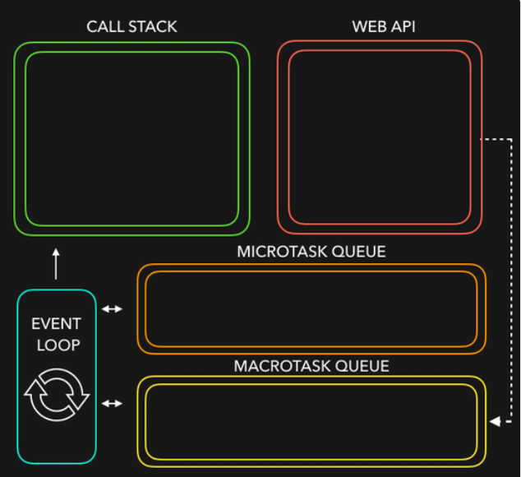
Let’s put it all together
JS/TS has single event loop
We outsource most of the non-blocking IO work (to WebAPIs) for asynchronous work
Upon completion, they are placed in queues (Microtask queue has priority over Macrotask queue)
Event loop picks them up from queue when call stack is empty!
Notes:
Javascript is a single threaded language. This means it has one call stack and one memory heap. It uses WebAPI to work asynchronously.
How do we get asynchronous code with Javascript then?
Well, we can thank the Javascript engine (V8, Spidermonkey, JavaScriptCore, etc...) for that, which has Web API that handle these tasks in the background. The call stack recognizes functions of the Web API and hands them off to be handled by the browser. Once those tasks are finished by the browser, they return and are pushed into a queue (callbacks go in Macrotask queue and promises go into microtask queue)
Then they are picked up by the event loop one by one and added onto the call stack.
Try this http://latentflip.com/loupe

Slide 33
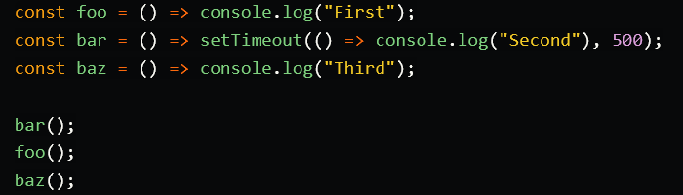
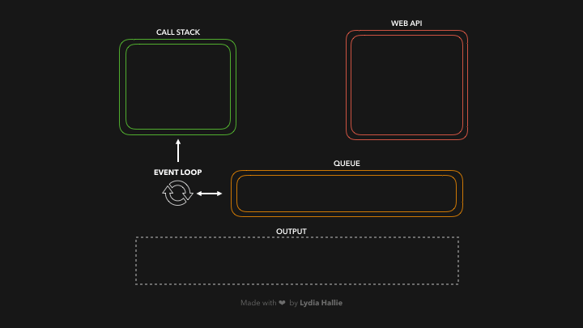
Quick demo
Courtesy of https://dev.to/lydiahallie/javascript-visualized-event-loop-3dif
Notes:
Courtesy of https://dev.to/lydiahallie/javascript-visualized-event-loop-3dif

Slide 34
Testing your understanding
const arr = [1, 2, 3];
for (const x of arr) {
console.log(`a${x}`);
}
for (const x of arr) {
await fetch('https://google.com’); // 1
console.log(`b${x}`);
}
await Promise.all( // 2
arr.map(async x => {
await fetch('https://google.com’); // 3
console.log(`c${x}`);
}),
);
arr.map(x => { console.log(`d${x}`); });

Slide 35
Pattern for testing an async function
import axios from 'axios'
async function echo(str: string) : Promise<string> {
const res =
await axios.get(`https://httpbin.org/get?answer=${str}`)
return res.data.args.answer
}
test('request should return its argument', async () => {
expect.assertions(1)
await expect(echo("33")).resolves.toEqual("33")
})
src/jest/jest-example.test.ts
Notes:
Let's change the subject. How do you test an async function? To test an async function, make the second argument to ‘test’ an async function. This will make ‘expect’ itself an async function, so you will need to ‘await’ its result.
This example is easy, since we are only sending some data to a public web site. If we wanted to do something that might have a global effect (e.g. a transcript database), we'd have to do some mocking. Alas, that is too much for this lecture ☺.
Here, echo is an async function, so it returns a promise, which should eventually return a string (here “33”) to the async function that called it (here, the expect). So here we are saying that we expect echo(33) to return a promise that will eventually resolve to “33”.
Note the await on the next to last line. If you leave that out, the async function in the test will succeed immediately, without waiting for the expect to run. The expect.assertions (in blue) tells Jest that the test should run exactly 1 test, so that will make the test fail if you leave out the await.

Slide 36
General Rules for Writing Asynchronous Code
You can’t return a value from a promise to an ordinary procedure.
  You can only send the value to another promise that is awaiting it.
Call async procedures only from other async functions or from the top level.
Break up any long-running computation into async/await segments so other processes will have a chance to run.
Leverage concurrency when possible
  Use promise.all if you need to wait for multiple promises to return.
Check for errors with try/catch

Slide 37
An Example Task Using the Transcript Server
Given an array of StudentIDs:
  Request each student’s transcript, and save it to disk so that we have a copy, and calculate its size
  Once all of the pages are downloaded and saved, print out the total size of all of the files that were saved

Slide 38
Generating a promise for each student
async function asyncGetStudentData(studentID: number) {
const returnValue =
await axios.get(`https://rest-example.covey.town/transcripts/${studentID}`)
return returnValue
}
async function asyncProcessStudent(studentID: number) : Promise<number> {
// wait to get the student data
const response = await asyncGetStudentData(studentID)
// asynchronously write the file
await fsPromises.writeFile(
dataFileName(studentID),
JSON.stringify(response.data))
// last, extract its size
const stats = await fsPromises.stat(dataFileName(studentID))
const size : number = stats.size
return size
}
Calling await also gives other processes a chance to run.
src/transcripts/simple.ts
Notes:
Each await is associated with a data dependency. DISCUSS: what is the data dependency for the second 'await'?

Slide 39
Running the student processes concurrently
async function runClientAsync(studentIDs:number[]) {
console.log(`Generating Promises for ${studentIDs}`);
const studentPromises =
studentIDs.map(studentID => asyncProcessStudent(studentID)) ;
console.log('Promises Created!');
console.log('Satisfying Promises Concurrently')
const sizes = await Promise.all(studentPromises);
console.log(sizes)
const totalSize = sum(sizes)
console.log(`Finished calculating size: ${totalSize}`);
console.log('Done');
}
Map-promises pattern: take a list of elements and generate a list of promises, one per element
src/transcripts/simple.ts

Slide 40
Output
runClientAsync([411,412,423])
$ npx ts-node simple.ts
Generating Promises for 411,412,423
Promises Created!
Satisfying Promises Concurrently
[ 151, 92, 145 ]
Finished calculating size: 388
Done

Slide 41
But what if there’s an error?
runClientAsync([411,412,87065,423,23044])
$ npx ts-node transcripts/simple.ts
Generating Promises for 411,412,87065,423,23044
Promises Created!
Satisfying Promises Concurrently
<blah blah blah>\node_modules\axios\lib\core\createError.js:16
var error = new Error(message);
^
Error: Request failed with status code 404
Oops!
Notes:
23044 is not the ID of any student

Slide 42
Need to catch the error
type StudentData = {isOK: boolean, id: number, payload?: any }
/** asynchronously retrieves student data, */
async function asyncGetStudentData(studentID: number): Promise<StudentData> {
try {
const returnValue =
await axios.get(`https://rest-example.covey.town/transcripts/${studentID}`)
return { isOK: true, id: studentID, payload: returnValue }
} catch (e) {
return { isOK: false, id: studentID }
}
}
Catch the error and transmit it in a form the rest of the caller can handle.
src/transcripts/handle-errors.ts

Slide 43
And recover from the error…
async function asyncProcessStudent(studentID: number): Promise<number> {
// wait to get the student data
const response = await asyncGetStudentData(studentID)
if (!(response.isOK)) {
console.error(`bad student ID ${studentID}`)
return 0
} else {
await fsPromises.writeFile(
dataFileName(studentID),
JSON.stringify(response.payload.data))
// last, extract its size
const stats = await fsPromises.stat(dataFileName(studentID))
const size: number = stats.size
return size
}
}
Design decision: if we have a bad student ID, we’ll print out an error message, and count that as 0 towards the total.
src/transcripts/handle-errors.ts
Notes:
It probably would have been better to put the try/catch here, where we intend to recover from the error.

Slide 44
New output
runClientAsync([411,32789,412,423,10202040])
$ npx ts-node transcripts/handle-errors.ts
Generating Promises for 411,32789,412,423,10202040
Promises Created!
Wait for all promises to be satisfied
bad student ID 32789
bad student ID 10202040
[ 151, 0, 92, 145, 0 ]
Finished calculating size: 388
Done

Slide 45
Odds and Ends You Should Know About

Slide 46
This is not Java!
src/data-races/dataRace.ts
let x : number = 10
async function asyncDouble() {
// start an asynchronous computation and wait for the result
await makeOneGetRequest(1);
x = x * 2 // statement 1
}
async function asyncIncrementTwice() {
// start an asynchronous computation and wait for the result
await makeOneGetRequest(2);
x = x + 1; // statement 2
// nothing can happen between these two statements!!
x = x + 1; // statement 3
}
async function run() {
await Promise.all([asyncDouble(), asyncIncrementTwice()])
console.log(x)
}
In Java, you could get an interrupt between statement 2 and statement 3.
In TS/JS statement 3 is guaranteed to be executed *immediately* after statement 2!
No interrupt is possible.
Notes:
In an interrupt-based model, it is possible that statement 1 runs *BETWEEN*
statement 2 and statement 3, yielding the order of execution
2,1,3 (final value of x is 25).
Luckily, in Typescript run-to-completion semantics, the "critical sections" are much larger; it is much harder to have an accidental data race– you pretty much have to work to create one.

Slide 47
But you can still have a data race
src/data-races/dataRace.ts
let x : number = 10
async function asyncDouble() {
// start an asynchronous computation and wait for the result
await makeOneGetRequest(1);
x = x * 2 // statement 1
}
async function asyncIncrementTwice() {
// start an asynchronous computation and wait for the result
await makeOneGetRequest(2);
x = x + 1; // statement 2
x = x + 1; // statement 3
}
async function run() {
await Promise.all([asyncDouble(), asyncIncrementTwice()])
console.log(x)
}
Notes:
You can still have a data race with async await. Here's the same program we looked at before. Here the printed value of x depends on which of the two promises returns first: if asyncDouble returns first, then the result will be 22 (10*2 + 1 + 1). If asyncIncrementTwice returns first, then the result will be 24 (10+1+1)*2 . But 25 is impossible!

Slide 48
Async/await code is compiled into promise/then code
async function makeThreeSerialRequests(){
1. console.log('Making first request’);
2. await makeOneGetRequest();
3. console.log('Making second request’);
4. await makeOneGetRequest();
5. console.log('Making third request’);
6. await makeOneGetRequest();
7. console.log('All done!');
}
makeThreeSerialRequests();
console.log('Making first request');
makeOneGetRequest().then( () =>{
console.log('Making second request');
return makeOneGetRequest();
}).then(() => {
console.log('Making third request');
return makeOneGetRequest();
}).then(()=>{
console.log('All done!');
});
Notes:
Promises

Slide 49
Promises Enforce Ordering Through “Then”
1. console.log('Making requests');
2. axios.get('https://rest-example.covey.town/')
.then((response) =>{
console.log('Heard back from server');
console.log(response.data);
});
3. axios.get('https://www.google.com/')
.then((response) =>{
console.log('Heard back from Google');
});
4. axios.get('https://www.facebook.com/')
.then((response) =>{
console.log('Heard back from Facebook');
});
5. console.log('Requests sent!');
axios.get returns a promise.
p.then mutates that promise so that the then block is run immediately after the original promise returns.
The resulting promise isn’t completed until the then block finishes.
You can chain .then’s, to get things that look like p.then().then().then()
Notes:
Promises enforce the order of operations only through the .then. The code in the ‘then’ won’t run until the promise is resolved.
(build through example, explaining the possible orders of results. Point out that we should never depend on the order of results we hear back form google/facebook/coveytown because it is non-deterministic. You might happen to see 9/10 times one ordering, but there is no guarantee)

Slide 50
The Self-Ticking Clock
To make the clock self-ticking, add the following line to your clock:
constructor () {
setInterval(() => {this.tick()},50)
}
Notes:
We said at the end of the last lecture that making a clock that ticks by itself was easy and that we would learn about it in the next lecture. Well, here it is.
setInterval is one of the JS primitives that creates a concurrent computation. Here, it creates a promise that ticks the clock every 50 ms.
We told you it was easy!

Slide 51
Async/Await Programming Activity
Download the activity (includes instructions in README.md):
Linked from course webpage for Module 6
Notes:
For this activity, you will work with an API client that we will provide to interact with our transcript server.
<read slide>

Slide 52
Review
You should now be prepared to:
  Explain the difference between JS run-to-completion semantics and interrupt-based semantics.
  Given a simple program using async/await, work out the order in which the statements in the program will run.
  Write simple programs that create and manage promises using async/await
  Write simple programs to mask latency with concurrency by using non-blocking IO and Promise.all in TypeScript.
Notes:
<read slide>

